Slide 1
“Teach A Level Maths”
Statistics 1
Introduction to Probability
© Christine Crisp

Slide 2
Statistics 1
AQA
EDEXCEL
MEI/OCR
OCR
"Certain images and/or photos on this presentation are the copyrighted property of JupiterImages and are being used with permission under license. These images and/or photos may not be copied or downloaded without permission from JupiterImages"

Slide 3
You have calculated probabilities in GCSE work and used tree diagrams to solve some probability problems.
We will now revise and extend probability work, starting with some definitions.
An experiment or trial has a number of outcomes. These are the results from the experiment or trial.
An event is a particular result or set of results. We usually use the word event for the outcomes we are interested in.
e.g. 1. If I toss a coin, the possible outcomes are a head or a tail. I could define H as the event of getting a head.
e.g. 2. If I roll a die, the possible outcomes are the numbers 1, 2, 3, 4, 5 or 6. An event could be getting an even number.

Slide 4

Let’s take the example of the die.
You know that the probability of the event “getting an even number” is
To see how we get this result formally, we need one more definition.
When we roll the die, there are 6 possible outcomes, all equally likely, and these form the possibility space.
For equally likely outcomes, the probability of an event, E, is given by
P (E) =
number of ways E can occur
number of possible outcomes
There are 3 even numbers and 6 possible outcomes so we get the answer 3 out of 6, or .

Slide 5
e.g. 1. Two dice are rolled and the sum of the numbers on the uppermost faces are added. What is the probability of getting a 7 ?
Thinking about this we realise that we can get 7 in a number of ways.
For example, 1 on the 1st die and 6 on the 2nd or 2 on the 1st and 5 on the 2nd. Also, what about 5 on the 1st and 2 on the 2nd ? There are also other possibilities.
These possibilities are equally likely so we can use the definition to find P (7) but it’s not easy to see in how many ways the event can arise.
To solve this problem we can draw a possibility space diagram and the answer is then easy to see.

Slide 6
e.g. 1. Two dice are rolled and the sum of the numbers on the uppermost faces are added. What is the probability of getting a 7 ?
Solution:
1st die
2nd die
+
1
2
3
4
5
6
We now count the number of 7s . . .
1
2
3
4
5
6
7
2
3
4
5
6
7
8
3
4
5
6
7
8
9
4
5
6
7
8
9
10
5
6
7
8
9
10
11
6
7
8
9
10
11
12

Slide 7
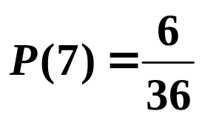

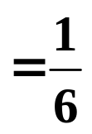

e.g. 1. Two dice are rolled and the sum of the numbers on the uppermost faces are added. What is the probability of getting a 7 ?
Solution:
1st die
2nd die
+
1
2
3
4
5
6
We now count the number of 7s . . .
1
2
3
4
5
6
7
2
3
4
5
6
7
8
3
4
5
6
7
8
9
and divide by the total number of possibilities.
4
5
6
7
8
9
10
5
6
7
8
9
10
11
6
7
8
9
10
11
12
So,

Slide 8

SUMMARY
Outcomes are the results of trials or experiments.
An event is a particular result or set of results.
A possibility space is the set of all possible outcomes.
For equally likely outcomes, the probability of an event, E, is given by
P (E) =
number of ways E can occur
number of possible outcomes

Slide 9

Exercise
1. Two dice are rolled and the score is defined as the product of the numbers showing on the uppermost faces. Write out the possibility space and use it to find the probability of scoring 12 or more.
2. Four coins are tossed. Write out the possibility space in the form of a list of all possible outcomes and use it to find the probability of 3 heads.

Slide 10
1. Two dice are rolled and the score is defined as the product of the numbers showing on the uppermost faces. Write out the possibility space and use it to find the probability of scoring 12 or more.
Solution:
1st die
2nd die
×
1
2
3
4
5
6
P ( 12 or more )
1
1
2
3
4
5
6
2
2
4
6
8
10
12
3
3
6
9
12
15
18
4
4
8
12
16
20
24
5
5
10
15
20
25
30
6
6
12
18
24
30
36

Slide 11
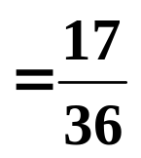
1. Two dice are rolled and the score is defined as the product of the numbers showing on the uppermost faces. Write out the possibility space and use it to find the probability of scoring 12 or more.
Solution:
1st die
2nd die
×
1
2
3
4
5
6
P ( 12 or more )
1
1
2
3
4
5
6
2
2
4
6
8
10
12
3
3
6
9
12
15
18
4
4
8
12
16
20
24
5
5
10
15
20
25
30
6
6
12
18
24
30
36

Slide 12
2. Four coins are tossed. Write out the possibility space in the form of a list of all possible outcomes, for example, H,H,H,H, and use it to find the probability of 3 heads.
Solution:
H,H,H,H
T,H,H,H | H,T,H,H | H,H,T,H | H,H,H,T
T,T,H,H | T,H,T,H | T,H,H,T | H,T,T,H | H,T,H,T | H,H,T,T
T,T,T,H | T,T,H,T | T,H,T,T | H,T,T,T
T,T,T,T
The probability P(A) of an event A is the sum of all
the probabilities of the outcomes which make up A

Slide 13
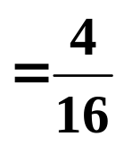

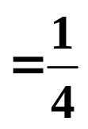

2. Four coins are tossed. Write out the possibility space in the form of a list of all possible outcomes, for example, H,H,H,H, and use it to find the probability of 3 heads.
Solution:
H,H,H,H
T,H,H,H | H,T,H,H | H,H,T,H | H,H,H,T
T,T,H,H | T,H,T,H | T,H,H,T | H,T,T,H | H,T,H,T | H,H,T,T
T,T,T,H | T,T,H,T | T,H,T,T | H,T,T,T
T,T,T,T
The probability P(A) of an event A is the sum of all
the probabilities of the outcomes which make up A
P ( 3 Heads )

Slide 14
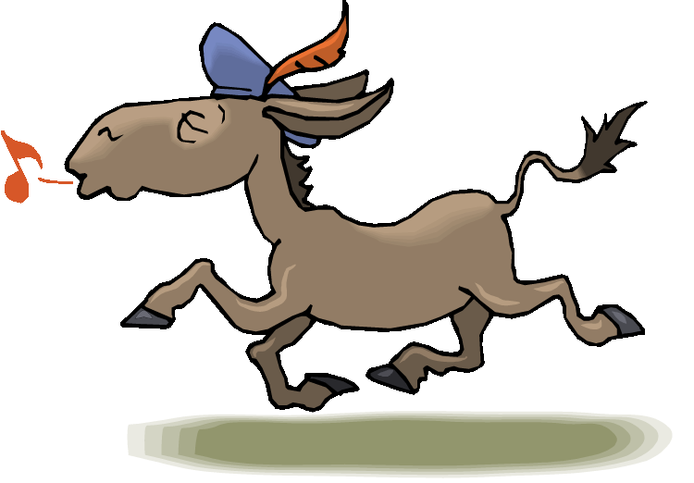

Slide 15
The following slides contain repeats of information on earlier slides, shown without colour, so that they can be printed and photocopied.
For most purposes the slides can be printed as “Handouts” with up to 6 slides per sheet.

Slide 16
SUMMARY
Outcomes are the results of trials or experiments.
An event is a particular result or set of results.
A possibility space is the set of all possible outcomes.
For equally likely outcomes, the probability of an event, E, is given by
P (E) =
number of ways E can occur
number of possible outcomes

Slide 17
e.g. 1. Two dice are rolled and the sum of the numbers on the uppermost faces are added. What is the probability of getting a 7 ?
Solution: We can show the possibility space in a table.
1st die
2nd die
+
1
2
3
4
5
6
We now count the number of 7s and divide by the total number of possibilities.
1
2
3
4
5
6
7
2
3
4
5
6
7
8
3
4
5
6
7
8
9
4
5
6
7
8
9
10
5
6
7
8
9
10
11
So,
6
7
8
9
10
11
12

